Slide 1
Primary vs Secondary Sources

Slide 2
What is a Primary Source?
It is first person
Descriptions or pictures of an event by someone who actually saw or lived through that event.

Slide 3
What is a Secondary Source?
It is not first person
Usually comes form people who were not present at the event.

Slide 4
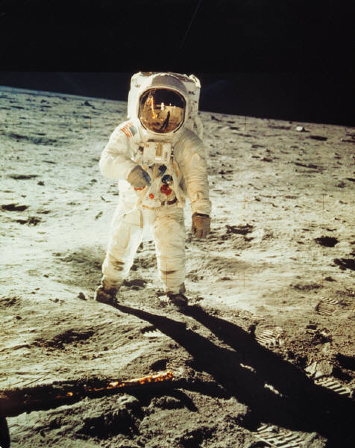
If you see a rocket launch and then write about it
Primary
Or
Secondary

Slide 5
Primary

Slide 6
If you find a journal or diary written by someone
Primary
Or
Secondary

Slide 7
Primary

Slide 8
If you find a photograph
Primary
Or
Secondary

Slide 9
Primary

Slide 10
If you find an Eyewitness report
Primary
Or
Secondary

Slide 11
Primary

Slide 12
If you find a book about history
Primary
Or
Secondary

Slide 13
Secondary

Slide 14
The author of a book collected information from many sources, combined info into something new.
Primary
Or
Secondary

Slide 15
Secondary

Slide 16
History books.
Primary
Or
Secondary

Slide 17
Secondary

Slide 18
Biographies & Histories.
Primary
Or
Secondary

Slide 19
Secondary

Slide 20
Definitions for Narrative of the Life of Olaudah Equiano
Allayed
To calm or pacify (an emotion); set to rest
Example Allayed the fears of the worried citizens
To reduce the intensity of; lessen or relieve
Victuals
Food fit for human consumption
Food supplies, provisions
To provide with food

Slide 21
Critical Thinking Skills

Slide 22
Cause and Effect
Cause is an ACTION
Or Situation that produces an effect
What happens as a result of the CAUSE is an effect
Understanding cause and effect means thinking about WHY and event occurred
It helps you see how one thing can lead to another .
This type of understanding can help you plan to encourage or prevent the same event in the future.

Slide 23
Drawing inferences and Conclusions
When you make inferences you READ BETWEEN THE LINES in order to figure out something that is not stated directly.
Conclusion
Is an understanding based on details or facts you read or hear.

Slide 24
Follow the steps
Inference
Read carefully for key facts and ideas, and list them.
Summarize information
Recall what you already know about the topic
Conclusion
Use your knowledge and insight to develop some inferences and conclusions about the passage

Slide 25
Is it Fact or Fiction
Use this to determine the validity of sources and find answers.
Check facts using reliable sources to determine whether or not they are accurate.
They answer specific questions such as
What happened?, or Who did it?

Slide 26
Opinions
Opinions are based on values and beliefs
They are NOT true or false
Opinions often begin with phrases such as
I believe….
Or contain words such as
Should, ought, best, worst, or greatest

Slide 27
Predicting
Predicting future events is difficult
Sometimes you can use knowledge of how certain causes led to certain effects in the past to make a prediction.
For example:
IF you know that conflicts over borders have often led to war, you might be able to predict the outcome of a current border dispute.

Slide 28
Making Comparisons
Look for similarities among ideas or objects
Examine contrasts-qualities that make each of the ideas or objects unique
When you make comparisons it helps you choose among several possible alternatives
To make comparisons and contrasts, you examine the texts, images, or other items and follow the steps.

Slide 29
The Steps
Select the times to compare
Determine what you are comparing
Examples:
Compare a topic or point of view.
Look for similarities within these categories
Look for differences that set the items apart from each other

