Slide 1
Duties and Responsibilities of Citizens

Slide 2
Some countries require much from their citizens such as serving in the armed forces for a period of time each year
Sometimes they are required to live far away from their families.
In the U.S. we ask much less of our citizens

Slide 3
What is a duty?
A duty is something that we are expected to carry out.
Duties are items that require us to do them
If we fail to perform them we can be subject to :
Fines and/or imprisonment

Slide 4
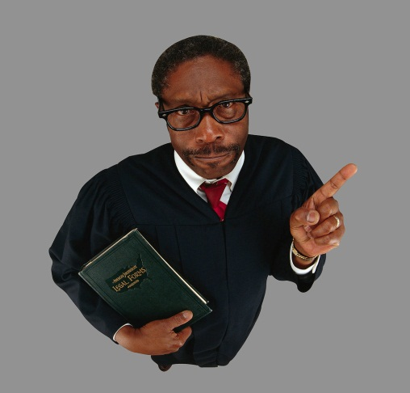
Obey the laws
This is probably the most important duty
If we do not obey laws we cannot maintain order and protect the health, safety, and property of all citizens
Criminal laws
Traffic laws
Local laws

Slide 5
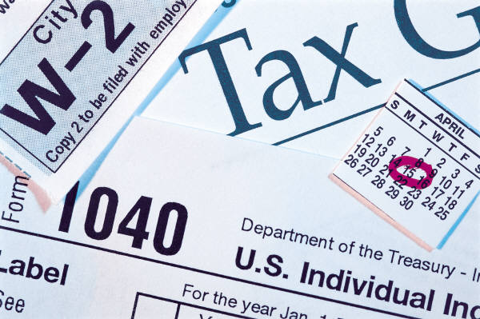


Pay taxes
Taxes pay for governments activities
Helps to pay for armed forces, schools, police, firefighters ,etc.
Federal income tax
State income tax
Local city tax
Sales tax
School district tax
Property tax

Slide 6
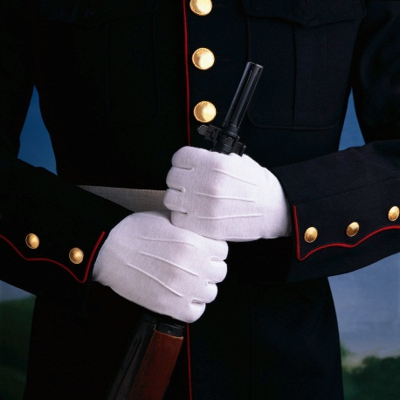
Defend the nation
All men age 18 and over are required to register with the selective services.
Draft if needed
No drafts since Vietnam
Government has the authority to use the draft if the country should suddenly go to war.

Slide 7
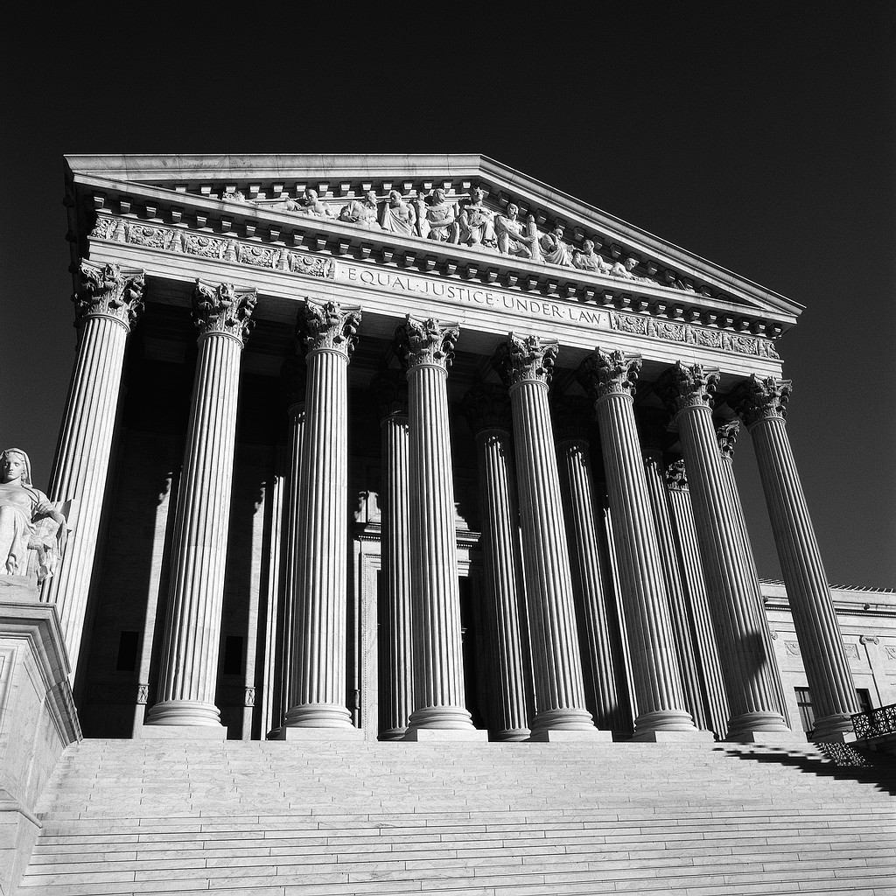
Serve in Court
Constitution guarantees every citizen the right to a trial by jury.
Every citizen must be prepared to serve on juries.
Can be excused for good reason
Give fair and just verdicts
Serve as witnesses if called to do so

Slide 8
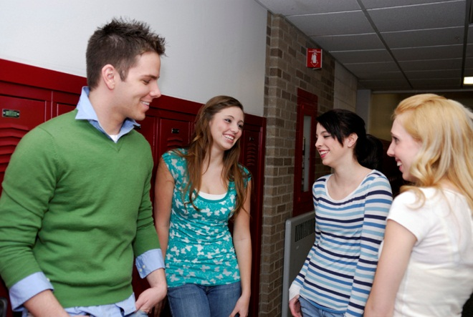

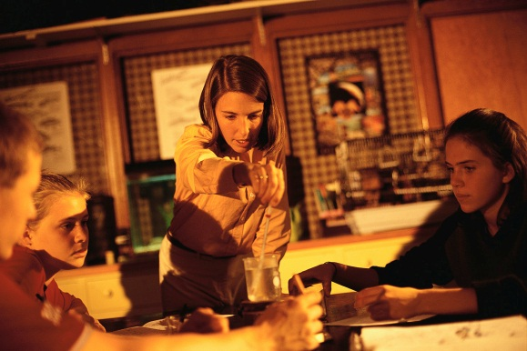
Attend School
Most states people are required to go to school until age 16.
School is how you acquire skills for your future careers.
Learn to be good citizens

Slide 9
What is a responsibility?
A responsibility are voluntary items.
They are not as clear cut as duties.
People are NOT arrested or punished if they do not fulfill the obligations.
If we do not do our responsibility our quality of life will diminish and so will our government.

Slide 10
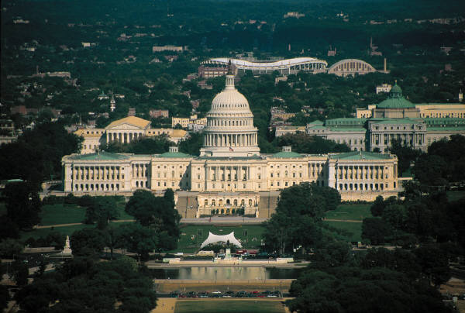
Be informed
Government exists to serve YOU.
Know what the government is doing
Voice your opinion on gov. actions
Government will favor majority
How can we help?

Slide 11

VOTE
One of the most important responsibilities we have
We choose those who represent us
If you do not like what is going on we have the right to choose someone else
Leadership is changed in a peaceful and orderly way

Slide 12
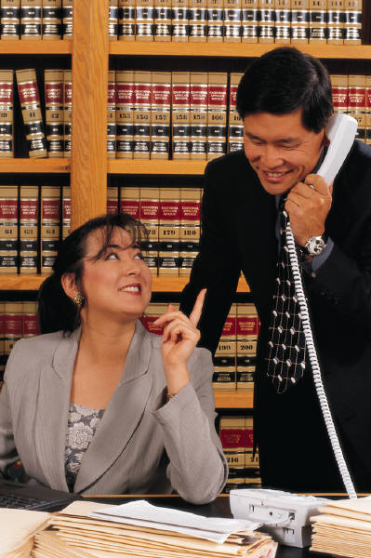
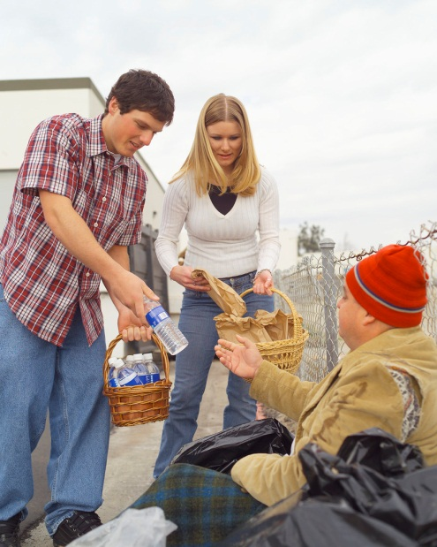
Participate in government
Participate in their community and the local government
What would it be like if no one would serve or volunteer?

Slide 13
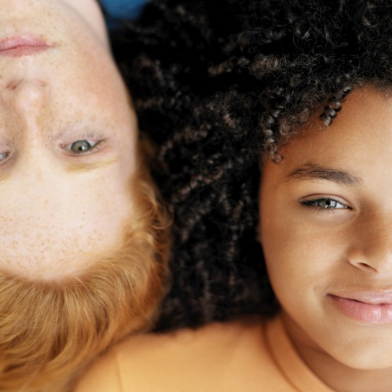
Respect the rights of others
Be prepared to respect the rights of others
For example obligation to keep volume down
Laws enacted to encourage people to respect each others rights
Respect for private and public property

Slide 14
THE
END

