Slide 1
The Lost Colony
Roanoke
Where did it go????

Slide 2
ROANOKE
Walter Raleigh established a colony of his own.
The year was
1585
It was difficult , suffered through a harsh winter colonists returned to England
John White, an artist made detailed pictures of what he saw.

Slide 3
ROANOKE
Didn’t give up his dream
In 1587
John White returned
This time, he sent 91 men, 17 women, and 9 children
Virginia Dare
First American born child of English parents-White’s Daughter

Slide 4
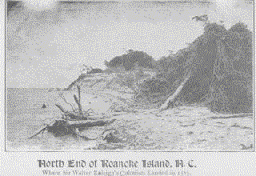
The north
shore of
Roanoke Island, N. C.

Slide 5
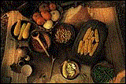
Typical foods of the area.
(Actually, the Colonists got this stuff
from their Native American neighbors.)

Slide 6
When he returned he found
entire colony had disappeared without
a trace. . .
Only one clue was found
the word
COROATOAN

Slide 7
Solving the puzzle
Historians have never stopped trying to find the answer to where the citizens of Roanoke went
2012 scientists used infrared light, x-ray spectroscopy along with other modern imaging machines
Discovered two small patches on a map drawn by John White
One patch might of covered what they think is another fort?

Slide 8
Puzzling Questions
Why would scientists be exited about this find?
Why do you think that patch might have been placed over the location of the fort?

Slide 9
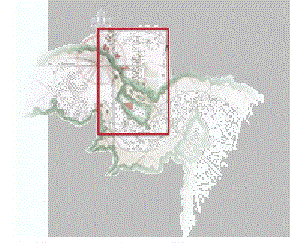
Different view of
Jamestown

Slide 10
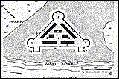
(Jamestown Fort)

Slide 11
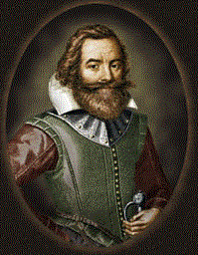
Captain
John Smith
(Handsome, ain’t he?)

Slide 12
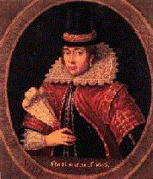
Pocahantas
Ain’t she . . .
CUTE!?

Slide 13
JAMESTOWN
King James I
tried colonizing again
joint-stock companies?
Virginia Company of Plymouth
&
Virginia Company of London

Slide 14
charter
James River
Named colony after the King
Jamestown

Slide 15
John Rolfe.
Grow Tobacco
$$$$$
Made lot’s of
Plantations
Indentured Servants

Slide 16
Choosing a Site
Virginia Co. chose site they considered:
Possible attacks by Powhatan
Possible attacks by Spanish
Far enough inland to be difficult for Spanish attack
Protected by a strong fort with several artillery weapons.

Slide 17
Choosing a Site
Water in harbor deep enough for ship to moor there
Important for possible trade with Great Britain & Europe
Good incase of colony evacuation
Early years Jamestown settlers could not survive without food from Powhatan.

Slide 18
House of Burgesses
Representative Government
Royal Colony

Slide 19
THE
END

