Slide 1
Triangular Trade
The Start of Slavery

Slide 2
Also Called the
Middle Passage
A voyage across the Atlantic Ocean
Enslaved Africans forced to endure

Slide 3
The Triangular Trade is a route to receive slaves.
It got it's name from the three routes that formed a triangle.

Slide 4
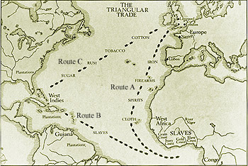
This was used to makes rum.
From the West Indies merchants
carried the rum, along with guns,
gunpowder, and tools to West Africa.
Here, they traded these items
for slaves, they carried the slaves
to the West Indies where they
were sold.
The first route carried fish, lumber,
and other goods from New England
to the West Indies.
In the West Indies they picked up
sugar and molasses which is a dark
brown syrup product made from sugar cane.
Traders would take the profits
and buy more molasses.

Slide 5
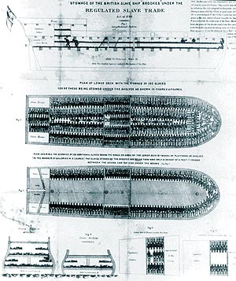
The slaves were treated so harshly that some of them didn’t make it to the West Indies. Traders were so greedy that they wanted to bring as many slaves as possible.

Slide 6
Between 1540 & 1850 15 million Africans transported to the Americas
Carried maximum amount on ship
The Brookes max = 451 but carried over 600
Chained together hands and feet
Only about half of Africans became effective workers in the Americas
Many died from diseases of smallpox & dysentery
Some committed suicide by not eating
Many were crippled for life by being chained
Purchase in Africa for $25, sold in Americas $150.
Declared Illegal prices were much higher
Tremendous profits even with 50% mortality

Slide 7
The slaves were chained and crammed together below the deck.
There was hardly any sitting room or standing room.

Slide 8
The slaves didn’t even have fresh air.
The air was so stifling that some suffocated to death.

Slide 9
Others tried to starve themselves to death or jump over board. Most died from diseases.
When the slaves reached the Americas they were auctioned off.
Many families were broken up and never seen again.

Slide 10
The Middle Passage was that leg of the slave triangle that
brought the human cargo from West Africa to North America,
South America, and the Caribbean.

Slide 11
The End

